Slide 1
UNIT-I PHONETICS & PRONUNCIATION
Chapter 1 Introduction to Phonetics
Chapter 2 Stress, Rhythm and Intonation
Chapter 3 Grammatical Words
Chapter 4 Past Tense and Plural Markers
Chapter 5 Understanding Different Accents

Slide 2
PART B - LANGUAGE LABORATORY
Unit - I PHONETICS AND PRONUNCIATION
Chapter 1 Introduction to Phonetics
Chapter 2 Word Stress Rules
Chapter 3 Weak Forms and Strong Forms
Chapter 4 Dealing with Problem Sounds
Chapter 5 Awareness of Different Accents

Slide 3
Introduction to Unit 1
Starts with the basic need of pronouncing properly all the 44 sounds of English
How to transcribe words in IPA
Pronounce each word correctly with the right Stress
Uttering each sentence with appropriate Intonation
Language Lab exercises is geared towards fine-tuning these basic skills
Training to use polite expressions, to learn telephone etiquette

Slide 4
Unit 1-Chapter 1-Introduction to Phonetics
Every language is a set of sounds
Understanding sounds facilitates correct pronunciation (RP)
Athlete, advertisement, career, police, student, academic
/ˈæθliːt// ədˈvɜːtɪsmənt//kəˈrɪə//pəˈliːs//ˈstjuːdənt//ˌækəˈdemɪk/
It helps us to be intelligible to the audience
Professionals with poor pronunciation may be judged as incompetent & untrained
Knowledge of sounds is essential component of communicative competence
Helps us to speak effectively & understand the message clearly

Slide 5
Challenge in English Language
In English language, the correspondence between written and spoken forms is not consistently maintained
Busy | s, i | breakfast | two words
laughter | f | lieutenant | f
church | ur | chaos | ao
judge | u, d | pause | au,s
student | u | comb | om,b
Father | r | queue | u, u:

Slide 6
Challenge in English Language
In English language, the correspondence between written and spoken forms is not consistently maintained
Busy | /ˈbɪzɪ / | ship | /ʃɪp/
laughter | /ˈlɑːftə/ | lieutenant | /leftenənt/
church | /ʧɜːʧ/ | chaos | /ˈkeɪɒs/
judge | /ˈʤʌʤ/ | pause | /pɔːz/
student | /ˈstjuːdənt/ | comb | /kəʊm/
Father | /ˈfɑːðə/ | queue | /kjuː/

Slide 7
What is Phonetics?
Is the science of human speech sound
Systematic study of the sounds of speech
Deals with pronunciation and representation of the sounds of speech
Term phone means sound
Languages are a set of sounds
Mechanism of speech: speech organs

Slide 8
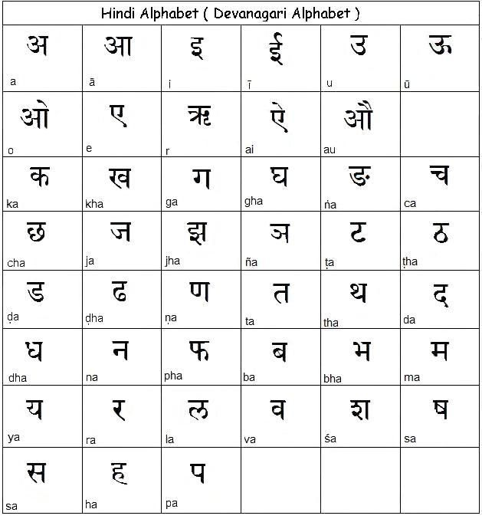
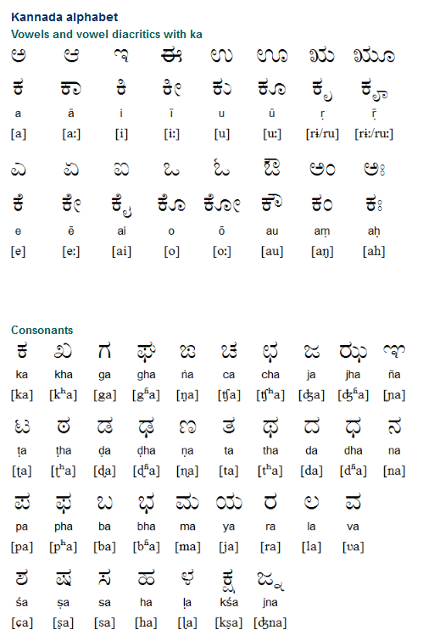
Sounds in Indian Languages

Slide 9
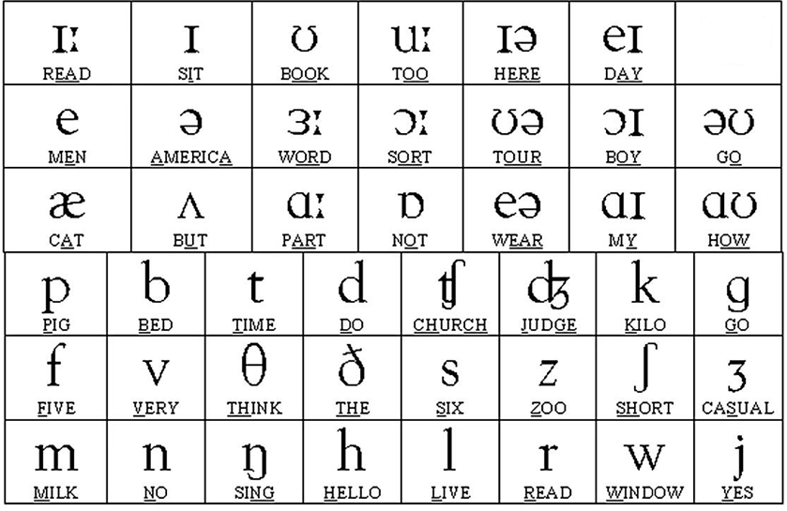
Sounds in English Language- Chart

Slide 10
Sounds in English Language-Classification
Subhashini Textbook: Page 11

Slide 11
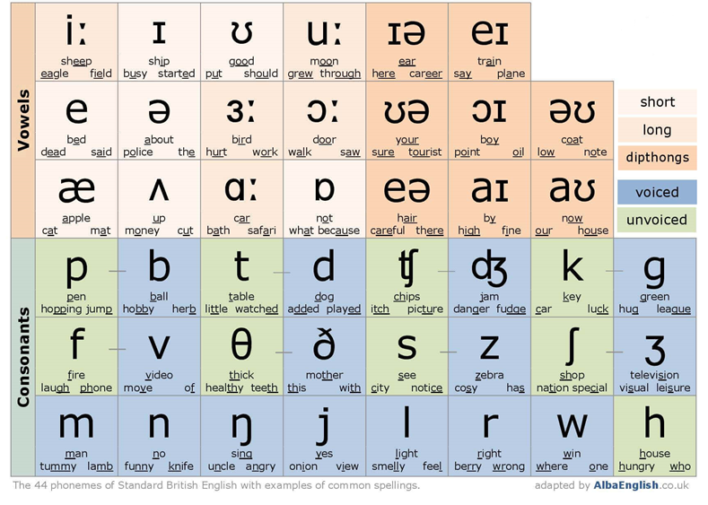
Phonemic Chart

Slide 12
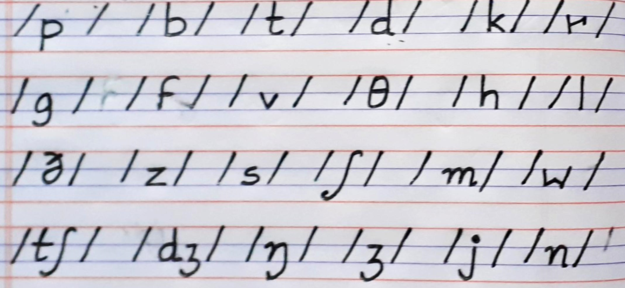
Consonant Sounds Symbols-Practice-Page 12

Slide 13
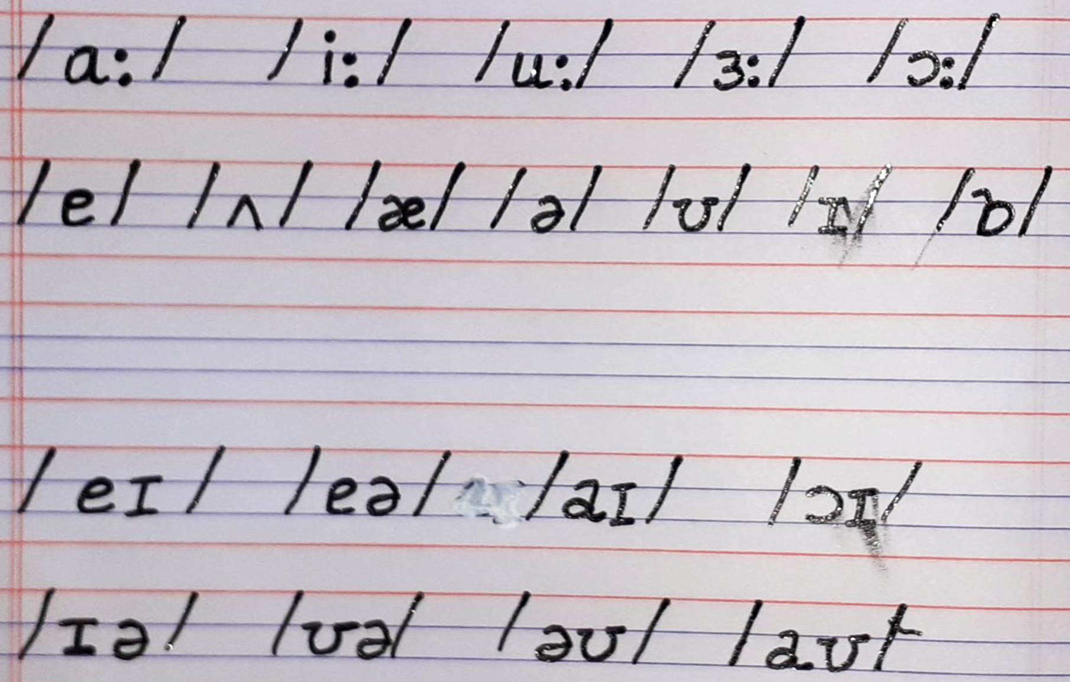
Vowels Sounds Symbols-Practice Page 12

Slide 14
Phonetic Transcription
Phonetic transcription means transcribing English words into IPA form
It is a kind of writing in which each symbol represents one sound
It helps the learners to understand the sound system of the language
The International Phonetic Association was established in 1949
IPA created phonetic symbols
It maintains international uniformity in pronunciation
Some examples of phonetic transcription of a few words :
pen - /pen/
tough - /tʌf/
flight - /flaɪt/

Slide 15
Vowels
a,e,i,o,u- not letters but sounds
Vowels are all voiced sounds without any constriction of air flow
The air comes out freely through the mouth without any closure or narrowing of passage
There are twenty vowels in English further classified into pure vowels & diphthongs
There are 12 pure vowels - 5 long and seven short
https://www.youtube.com/watch?v=72M770xTvaU (single vowels)
Diphthongs are a combination of two short vowels.
There are 8 Diphthongs
https://www.youtube.com/watch?v=d1HZPx8DuDw

Slide 16
Vowels-Pure Vowels Monophthongs-Long 05
Sound | Example | Transcription
/ɑ:/ | car, ask | /kɑːr/ /ɑːsk/
/i:/ | seat, beat | /siːt/ / biːt /
/u:/ | pool, do | /puːl/ / du: /
/з:/ | birth, hurt | /bɜːθ/ / hɜːt/
/ɔ:/ | fall, fought | /fɔːl/ //fɔːt/

Slide 17
Vowels-Pure Vowels-Monophthongs-short 07
Sound | Example | Transcription
/e/ | pen, men | /pen/ /men/
/ʌ/ | bus, tub | /bʌs/ /tʌb/
/æ/ | mat, fat | /mæt/ /fæt /
/ə/ | about, above | /əˈbaʊt/ /əˈbʌv/
/ʊ/ | book, took, pull | /bʊk/ /tʊk/ /pʊl/
/ɪ/ | sit, bit | /sɪt/ /bɪt/
/ɒ/ | hot, opt | /hɒt/ /ɒpt/

Slide 18
Diphthongs-08
Sound | Example | Transcription
/eɪ / | gate, say | /geɪt/ /seɪ/
/eə/ | fair, hair | /feə/ /heə/
/aɪ/ | night, nice | /naɪt/ /naɪs/
/ɔɪ/ | toy, oil | /tɔɪ/ /ɔɪl /
/ɪə/ | near, year | /nɪə/ /jɪə /
/ʊə/ | poor, tour | /pʊə/ /tʊə/
/əʊ/ | no, gold | /nəʊ/ /gəʊld/
/aʊ/ | bow, doubt | /baʊ/ /daʊt/

Slide 19
Consonants
Consonants are sounds produced with some curb or closure in the vocal tract
There are twenty-four consonants in English Language
Can be divided into familiar and unfamiliar
Familiar- ex:/p//b//t//d//k//g//l/
Unfamiliar-ex::/θ//ð//ʃ//tʃ//ŋ//j//ʒ/
Can be further divided into voiced and voiceless
Single consonants-https://www.youtube.com/watch?v=h4yrIuCE6UM
Paired consonants-https://www.youtube.com/watch?v=zoarwB-7O_c

Slide 20
Consonants-Voiced and Voiceless
After every voiceless consonant ending except /t/, the past tense marker –ed is pronounced /t/. Ex:help-helped /helpt/
After every voiced sound ending except /d/, the past tense marker–ed is pronounced /d/.love loved /lʌvd/
After every voiceless consonant ending except /s/, /ʃ/ and /tʃ/; the plural is formed using/s/.cat cats /kæts/ map maps /mæps/
After every voiced sound ending except /z/, /ʒ/ and /dʒ/; the plural is formed using /z/.
bag bags /bægz/dog dogs /dɒgz/

Slide 21
24 Consonants- 08 each in 03 slides
Sound | Example | Transcription
/p/ | pan, cap, paper | /pæn//ˈkæp//ˈpeɪpə/
/b/ | bat, bud, bus | /bæt/ /bʌd/ /bʌs/
/t/ | table, tiger, rust | /ˈteɪbl//ˈtaɪgə// rʌst/
/d/ | dam, doll, bud | /dæm// dɒl //bʌd /
/k/ | black, cake, kite | /blæk// keɪk// kaɪt /
/g/ | gate, gigantic, great | /geɪt/ʤaɪˈgæntɪk/ / greɪt /
/f/ | fan, after, effect | /fæn//ˈɑːftə//ɪˈfekt/
/v/ | van, hive, five | /væn/ /haɪv// faɪv/

Slide 22
24 Consonants- 08 each in 03 slides
Sound | Example | Transcription
/θ/ | thin, method, bath | /θɪn/ /ˈmeθəd// bɑːθ/
/ð/ | then, there, mother | /ðen/ /ðeə//ˈmʌðə /
/s/ | sweet, ice, bus | /swiːt/ /aɪs/ /bʌs /
/z/ | zero, zoo, puzzle | /ˈzɪərəʊ/ /zuː/ /ˈpʌzl/
/ʃ/ | sheep, fashion, machine | /ʃiːp//ˈfæʃən/ /məˈʃiːn/
/ʒ/ | leisure, vision, measure | /ˈleʒə///ˈvɪʒən/ /ˈmeʒə/
/h/ | handle, horse, rehearse | /ˈhændl// hɔːs/ /rɪˈhɜːs/
/tʃ/ | chit, chest, such | /ʧɪt/ /ʧest/ /sʌʧ/

Slide 23
24 Consonants- 08 each in 03 slides
Sound | Example | Transcription
/dʒ/ | cage, jam, charge | /keɪʤ/ /ʤæm// ʧɑːʤ/
/m/ | mat, monthly, common | /mæt// ˈmʌnθlI/ /ˈkɒmən/
/n/ | can, neat, number | /kæn// niːt// ˈnʌmbə/
/ŋ/ | building, bank, drink | /ˈbɪldɪŋ// bæŋk/ /drɪŋk /
/l/ | late, call, balloon | /leɪt// kɔːl //bəˈluːn/
/r/ | red, marry, car | /red// ˈmærI// kɑː /
/j/ | yes, you, yolk | /jes// juː// jəʊk /
/w/ | woman, wonder, water | /ˈwʊmən// ˈwʌndə/ /ˈwɔːtə/

Slide 24
Find the Number of Syllables
/pəˈtɪkjʊlə//ˈmjuːzɪk// mjuˈzɪʃən/
/red/ /θred/ /ˈbrekfəst/
/wel-rɪsˈpektɪd/ /ˈgʊdˈlʊkɪŋ//ˌbaɪəʊˈlɒʤɪkəl/
/ˌkɑːdɪˈɒləʤI/ /ˌfɪzɪəˈlɒʤɪkəl//əbˈʤekt//ˈɒbʤɪkt/
/ kənˈtent//ˈkɒntent/ /ˈtiːʧə/ /ˈliːdə/
/flaɪt/ /rəʊz/ /dʒʌdʒ/
/sʌn/ /'fɪzɪks/ / ɪgˌzæmɪˈneɪʃən/
/ded//ˈfʊtbɔːl/ /dɪ'veləp/

Slide 25
Syllable-Phonetic Transcription
Phoneme is a segment of sound
Ex:/p//b//I//e/
Syllable is combination of consonant and vowel sounds:
Ex:Leader /ˈliːdə/ Particular/pəˈtɪkjʊlə/
A syllable can have more than one consonant but the presence of vowel is compulsory
Ex:/pəˈtɪkjʊlə/
A syllable is a complete sound
Vowel is the heart of a syllable –Number of vowels in a word decide the number of syllables
Ex:Mathematics /ˌmæθɪˈmætɪks/ Pomegranate/ ˈpɒmˌgrænɪt/ Preparatory/prɪˈpærətərI/ Restaurant /ˈrestrɒnt/ February /ˈfebrʊərI /

Slide 26
Syllable & Stress
Number of syllables decide the accent/stress
Ex:/pəˈtɪkjʊlə//ˈmjuːzɪk/
Syllables like tion/ʃən/ decide the stress
Ex:/ mjuˈzɪʃən/ /ɪgˌzæmɪˈneɪʃən/
Let us learn more about stress according to number of syllables in the next chapter

Slide 27
Phonetics Practice Exercise 1
Here are given some words in IPA. Transcribe them to Orthography.
/ɪ'nʌf/ ______________ 14. /θʌm/ ______________
/ʃʌn/ ______________ 15. /dʒi:p/ ______________
/ə'trækt/ _____________ 16. /sɜ:tʃ/ ______________
/fi:ld/ ______________ 17. /mɑ:tʃ/ ______________
/weɪt/ ______________ 18. /rɒŋ/ ______________
/dʒʌdʒ/ ______________ 19. /'kɒlɪdʒ/ ______________
/flʌd/ ______________ 20. /hɑ:m/ ______________
/ɑ:t/ ______________ 21./jʌŋ/ ______________
/jæm/ ______________ 22. /ʃɜ:t/ ______________
/'ri:zən/ ______________ 23. /'leɪbə/ ______________
/deɪt/ ______________ 24. /'əʊvə/ ______________
/mʌnθ/ ______________ 25. /tʃɪə/ ______________
/ʃʊə/ ______________

Slide 28
Phonetics Practice Exercise 2
Transcribe the following words in IPA.
Pace ______________
Teacher ______________
Cool ______________
After ______________
Start ______________
Mat ______________
East ______________
Catch ______________
Judge ______________
Thick ______________
Coffee ______________
Special ______________

Slide 29
Phonetics Practice Exercise 2
Pace /peIs/
Teacher /ˈtiːʧə/
Cool /kuːl/
After /ˈɑːftə /
Start /stɑːt/
Mat /mæt/
east / iːst/
Catch /kæʧ/
Judge /ˈʤʌʤ/
Thick /θɪk/
Coffee /ˈkɒfI/
special /ˈspeʃəl/

Slide 30
Exercise 4
pen | thorn | turn | field
flight | develop | Van | shield
rose | attract | prompt | book
judge | account | start | reader
sun | delete | engineer | union
Physics | Math | bat | tough

Slide 31
Exercise 4
pen | /pen/ | thorn | /θɔ:n/
flight | /flaɪt/ | develop | /dɪ'veləp/
rose | /rəʊz/ | attract | /ə'trækt/
judge | /dʒʌdʒ/ | account | /ə'kaʊnt/
sun | /sʌn/ | delete | /dɪ'li:t/
Physics | /'fɪzɪks/ | Math | /mæθ/

Slide 32
Exercise 4
turn | /tɜ:n/ | field | /fi:ld/
Van | /væn/ | shield | /ʃi:ld/
prompt | /prɒmpt/ | book | /bʊk/
start | /stɑ:t/ | reader | /'ri:də/
engineer | /endʒɪ'nɪə/ | union | /'ju:nɪən/
bat | /bæt/ | tough | /tʌf/

Slide 33
Exercise 5
night | no | race | gain
shun | and | uncle | water
coffee | maintain | canteen | day
torn | educate | ask | ring
fun | democracy | seat
special | view | future

Slide 34
Exercise 5
night | /naɪt/ | no | /nəʊ/
shun | /ʃʌn/ | and | /ænd/
coffee | /'kɒfɪ/ | maintain | /meɪn'teɪn/
torn | /tɔ:n/ | educate | /e'dʒʊkeɪt/
fun | /fʌn/ | democracy | /dɪ'mɒkrəsɪ/
special | /'speʃəl/ | view | /vju:/

Slide 35
Exercise 5
race | /reɪs/ | gain | /geɪn/
uncle | /'ʌŋkl/ | water | /'wɔ:tə/
canteen | /'kænti:n/ | day | /deɪ/
ask | /ɑ:sk/ | ring | /rɪŋ/
seat | /si:t/
future | /'fju:tʃə/

